Slide 1
Efficient Client selection in Federated Learning
𝝿0

Slide 2
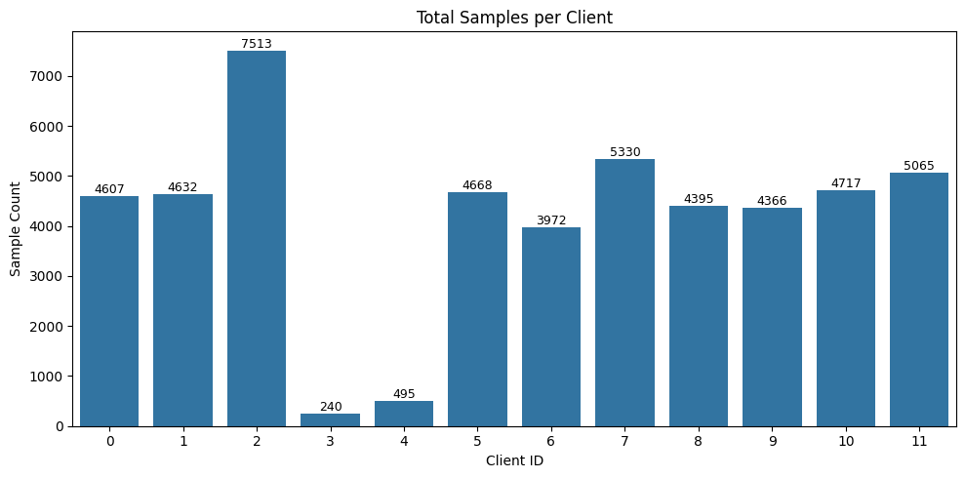
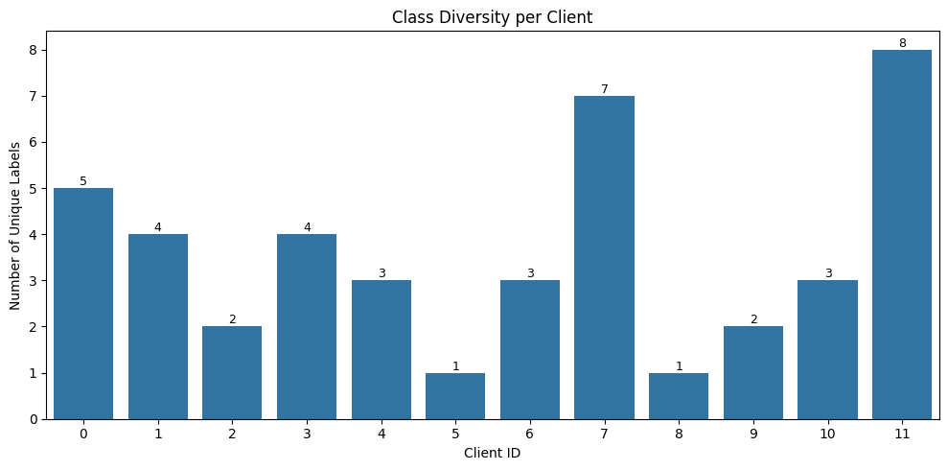
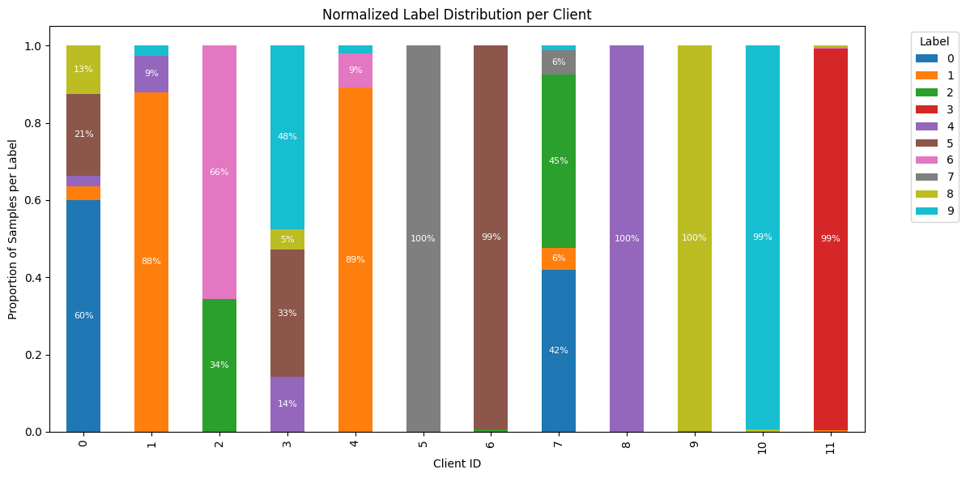
Pre-client data analysis

Slide 3
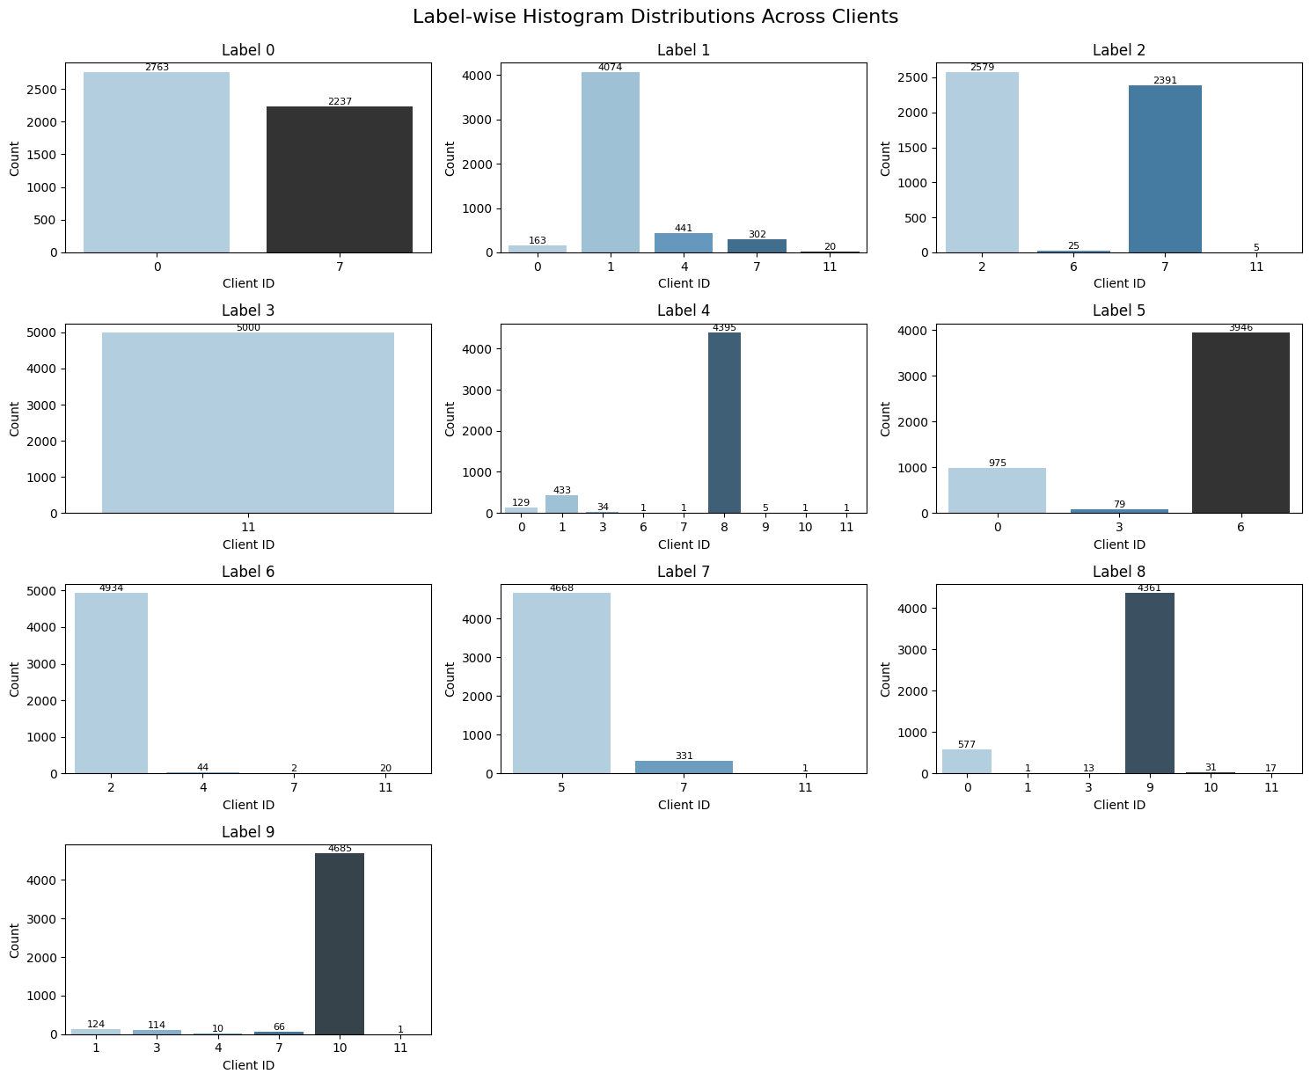
Pre-client data analysis

Slide 4
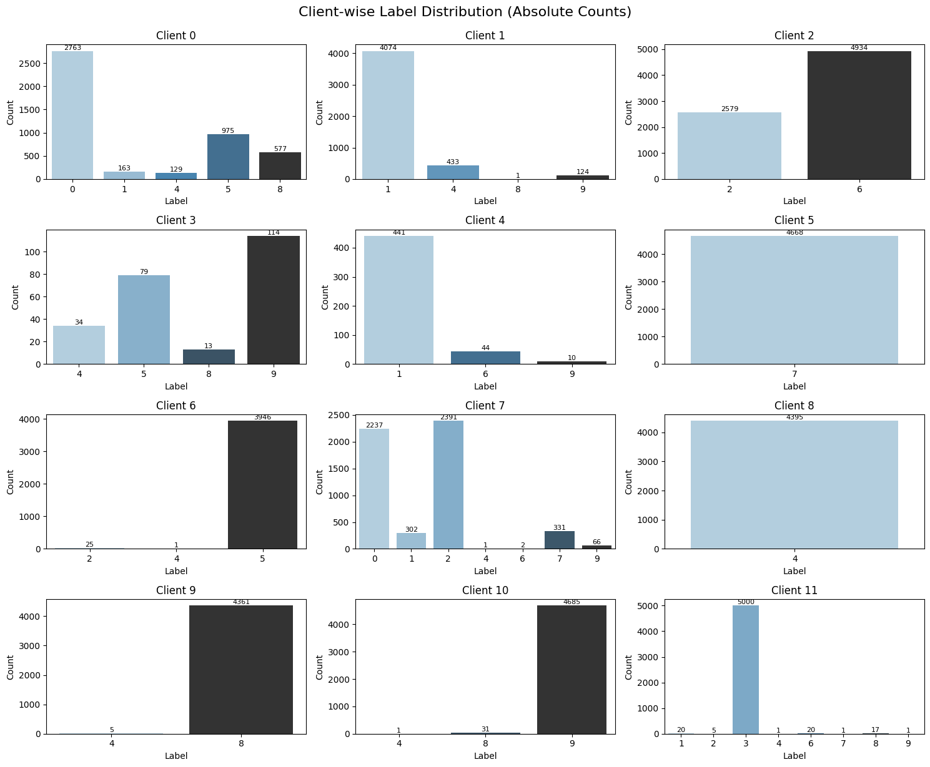
Pre-client data analysis

Slide 5
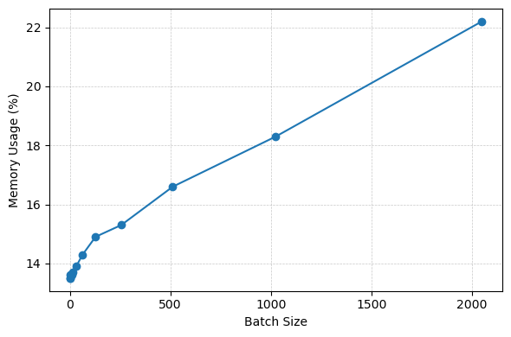
Profiling client training time

Slide 6
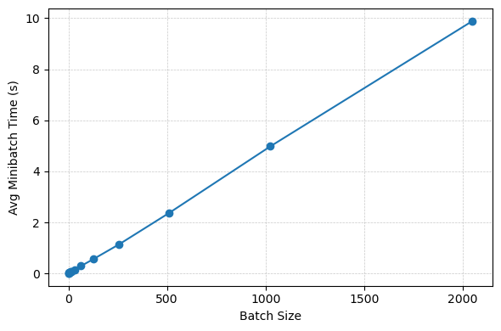
Profiling client training time

Slide 7
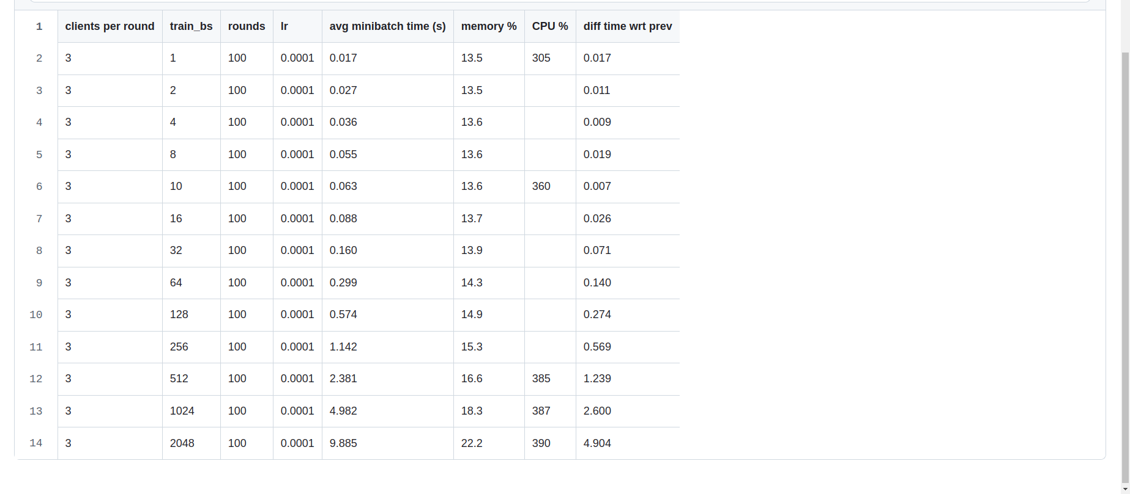
Task 3 - Batch Size 10

Slide 8
Random Client Selection
Client ID | # Times Selected | Avg Accuracy | Contribution
0 | 3 | ~73.6% | Moderate
1 | 4 | ~51.1% | Low
2 | 2 | ~99.6% | High
3 | 5 | ~58.8% | Low
4 | 4 | ~79.0% | Moderate
5 | 2 | ~98.3% | High
6 | 1 | ~98.2% | High (Limited Sample)
7 | 1 | ~83.3% | Moderate
8 | 4 | ~98.9% | High
9 | 1 | ~76.2% | Moderate
10 | 2 | ~95.9% | High
11 | 4 | ~98.5% | High

Slide 9
Informed Client Selection Strategy
The client_selection_score_based function introduces an informed strategy for selecting clients based on multiple performance and contribution factors. It computes a composite score for each client, reflecting their effectiveness in improving the model relative to the time and data used.
First, for each client, it retrieves the number of times the client was selected (selection_count), the average test accuracy achieved (avg_accuracy), the number of training samples (num_samples), and the average training time per minibatch (avg_minibatch_time). Using this data, the function calculates a score that balances the client’s contribution to model accuracy, efficiency (accuracy per unit time), and the quantity of data they hold. Each score is normalized with a small epsilon to avoid division by zero and ensure numerical stability.
Once scores are computed for all clients, the function ranks them and selects the top k clients as determined by args["num_clients_per_round"]. This ensures the server always engages with the most promising subset of clients per round, instead of relying on chance.

Slide 10
Client Selection Strategy
Aspect | Random Selection | Score-Based Selection (Proposed)
Selection Mechanism | Uniform random sampling | Top-k selection based on composite client score
Metric Awareness | None | Uses accuracy, data size, training speed, and contribution
Historical Data Usage | No | Yes
Client Utility Consideration | Ignored | Explicitly considered via scoring
Training Efficiency | Variable, often suboptimal | Higher, due to prioritization of efficient and impactful clients
Model Convergence | Slower and stochastic | Faster and more stable
Fairness Across Clients | Equal opportunity | Biased toward high-performing clients
Complexity | Low (O(1) per round) | Moderate (O(n) scoring, O(n log n) sorting)
Scalability | Poor performance with large, diverse client sets | Better suited for heterogeneous environments

